Slide 1

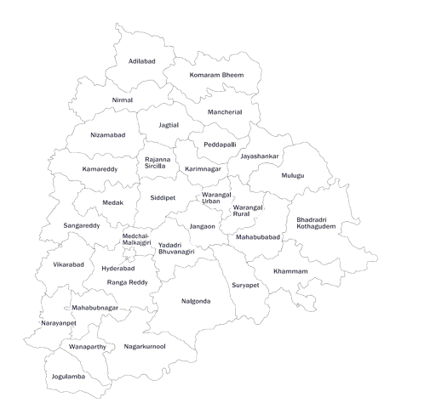
TELAGANA Growth Analysis

Slide 2
STAKEHOLDERS
Shri K T Rama Rao
Minister for Information Technology, Electronics & Communications (IT, E&C), Industries & Commerce, and Municipal Administration & Urban Development (MA & UD), Government of Telangana
Jayesh Ranjan
Principal Secretary, Department of Information Technology, Electronics & Communications (ITE&C) and Department of Industries & Commerce, Government of Telangana
Dileep Konatham
Director at Government of Telangana
Venu Panjarla
Open Data Telangana

Slide 3
CODEBASICS TEAM
Dhaval Patel
Founder, Codebasics
Hemanand Vadivel
Co-Founder, Codebasics

Slide 4
TABLE OF CONTENTS
1
PROJECT OVERVIEW
2
OBJECTIVE
Edit Text
3
PRELIMINARY INSIGHTS
Edit Text
4
SECONDARY INSIGHTS
Edit Text

Slide 5
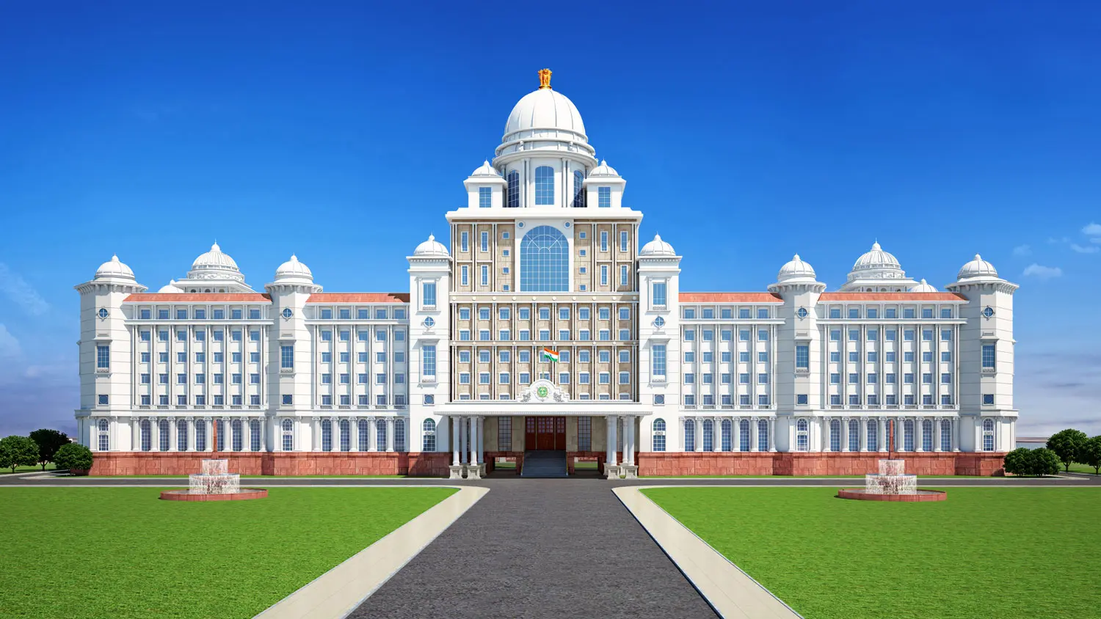
PROJECT OVERVIEW
The Telangana Growth Analysis project involves analyzing data from Stamp Registration, Transportation, and Ts-Ipass datasets to uncover trends, correlations, and growth opportunities. The goal is to provide valuable insights and recommendations to support informed decision-making for the state's development. The project integrates geospatial mapping to visualize insights at the district level and aims to engage top-level management with a persuasive presentation and notification strategy

Slide 6
OBJECTIVE
Descriptive Analysis
Exploratory Data Analysis
01
02
03
Strategic Analysis
Multivariate Analysis
04
Explore Stamp Registration, Transportation and Ts-Ipass Datasets. Understand their attributes, categories and time period.
Analyze trends and patterns within each department.
Identify growth opportunities and areas needing attention.
Find correlation among these departments and report the overall growth of the state through insights and relevant visuals such as shape maps.

Slide 7

PRELIMINARY INSIGHTS

Slide 8

STAMP REGISTRATION

Slide 9
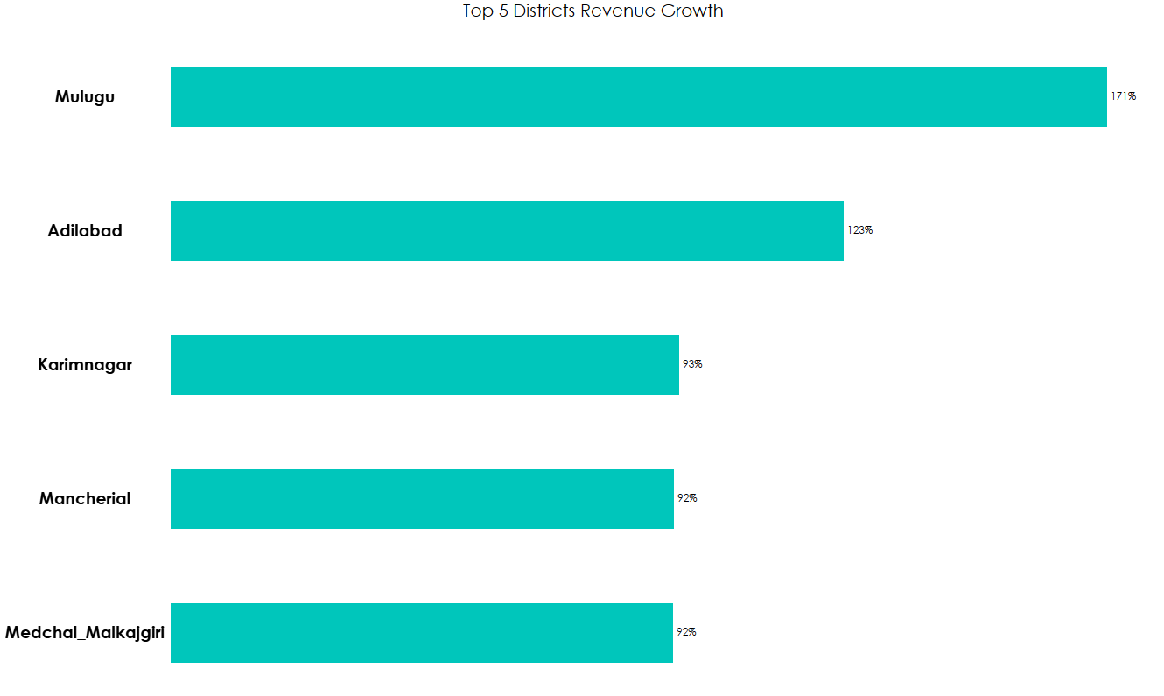
1. How does the revenue generated from document registration vary across districts in Telangana? List down the top 5 districts that showed the highest document registration revenue growth between FY 2019 and 2022.
Mulugu: The district achieved an impressive 171% growth in document registration revenue, reflecting strong economic activity and property transactions..
Adilabad: Adilabad district's second-highest ranking growth of 123% in document registration revenue highlights its vibrant real estate market.

Slide 10
1. How does the revenue generated from document registration vary across districts in Telangana? List down the top 5 districts that showed the highest document registration revenue growth between FY 2019 and 2022.
Mulugu: The district achieved an impressive 171% growth in document registration revenue, reflecting strong economic activity and property transactions.
Adilabad: Adilabad district's second-highest ranking growth of 123% in document registration revenue highlights its vibrant real estate market.

Slide 11
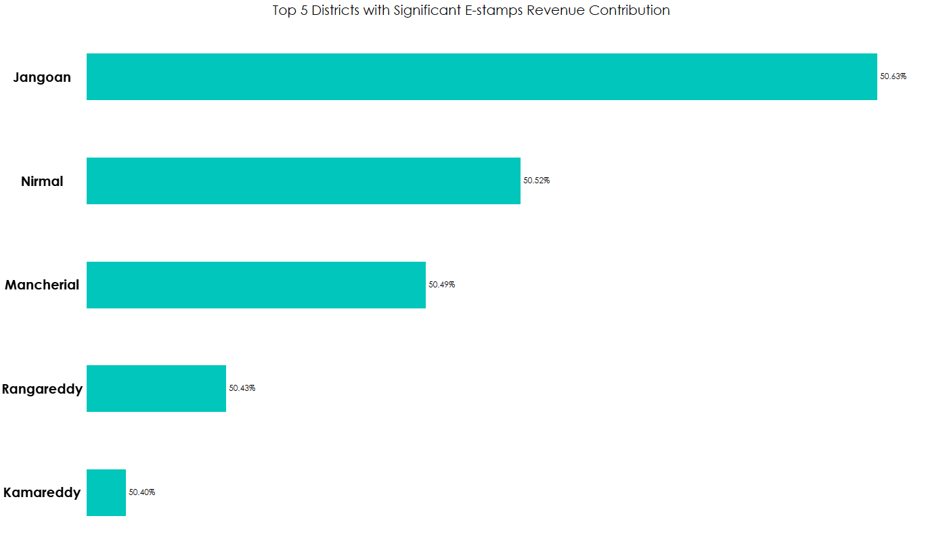
2.How does the revenue generated from document registration compare to the revenue generated from e-stamp challans across districts? List down the top 5 districts where e-stamps revenue contributes significantly more to the revenue than the documents in FY 2022?
Jangoan: The District takes the lead in e-stamps revenue generation, constituting 50.63% of its total revenue, which amounted to ₹ 486 million, while the revenue generated from document registration stood at ₹474 million.
Nirmal: The District ranks as the second-highest in e-stamp revenue contribution, accounting for 50.52% of its total revenue. E-stamp revenue amounted to ₹ 346 million, closely followed by document revenue at ₹ 339 million.

Slide 12
2.How does the revenue generated from document registration compare to the revenue generated from e-stamp challans across districts? List down the top 5 districts where e-stamps revenue contributes significantly more to the revenue than the documents in FY 2022?
Jangoan: The District takes the lead in e-stamps revenue generation, constituting 50.63% of its total revenue, which amounted to ₹ 486 million, while the revenue generated from document registration stood at ₹474 million.
Nirmal: The District ranks as the second-highest in e-stamp revenue contribution, accounting for 50.52% of its total revenue. E-stamp revenue amounted to ₹ 346 million, closely followed by document revenue at ₹ 339 million.

Slide 13
3. Is there any alteration of e-Stamp challan count and document registration count pattern since the implementation of e-Stamp challan? If so, what suggestions would you propose the government?

Slide 14
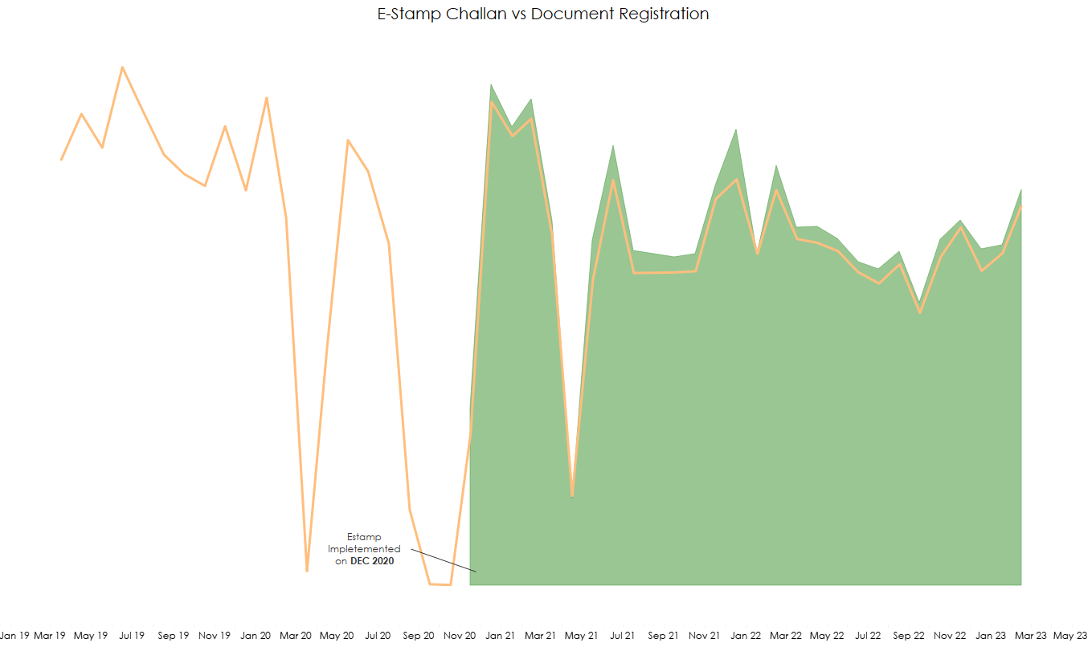
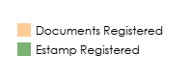
3. Is there any alteration of e-Stamp challan count and document registration count pattern since the implementation of e-Stamp challan? If so, what suggestions would you propose to the government?
After implementing e-stamps in December 2020, there was a sudden surge in revenue, and it has since maintained a balanced 50-50 ratio between e-stamp and document registration revenue.

Slide 15
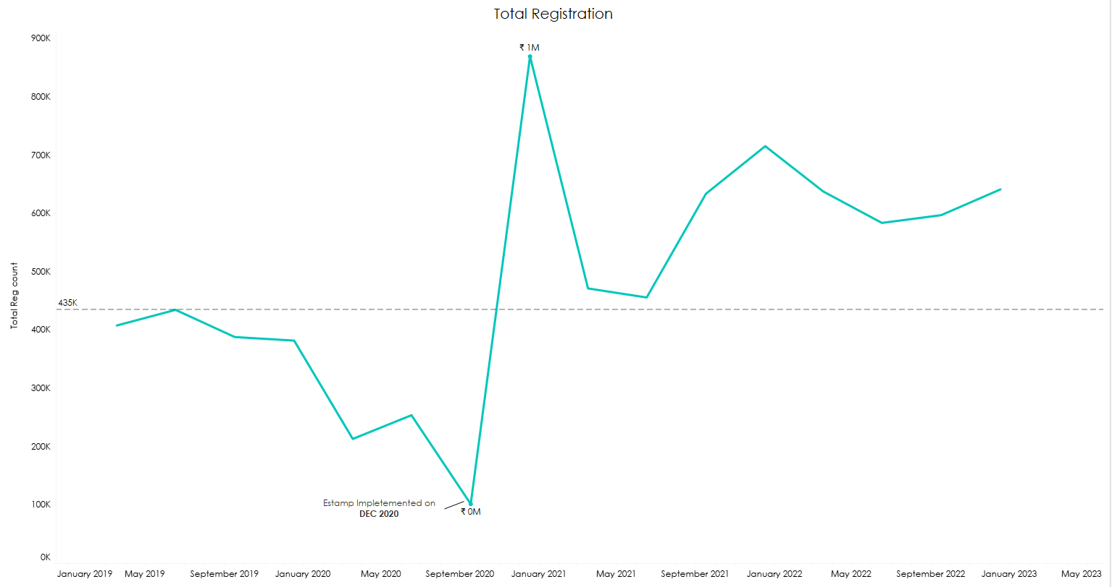
3. Is there any alteration of e-Stamp challan count and document registration count pattern since the implementation of e-Stamp challan? If so, what suggestions would you propose to the government?
Before the implementation of e-stamps, the highest revenue was 435k After implementation, it reached a peak of
1 million and has since maintained an average of approximately 600k

Slide 16
Suggestion for Government
Promote E-Stamp Awareness: Sustain initiatives to enhance awareness of E-Stamp within the community, enterprises, and legal organizations. Implement educational campaigns and offer resources to ease the shift from conventional stamps to digital ones.
Create Step-by-Step YouTube Tutorials: Develop comprehensive step-by-step YouTube tutorials on how to generate e-stamps from the website. These tutorials should cater to users of all levels of technical expertise, making the process easy to understand.
Streamline Payment Options: Make payment options more user-friendly by offering a variety of payment methods, including credit/debit cards and digital wallets. Additionally, consider providing concessions for transactions made using UPI (Unified Payments Interface) to incentivize its usage.
Simplify User Interface: Ensure that the website's user interface is simple, clean, and user-friendly. Avoid unnecessary complexity to make it accessible to a wide range of users.
Include Local Language (Telugu): Offer the website in the local language (Telugu) in addition to the standard English format. This will enhance accessibility for users who are more comfortable with their native language.
Provide Customer Support: Establish a customer support system to assist users who may have doubts or encounter errors while using the e-stamp platform. Ensure that customer support is available during normal working hours to assist users promptly and efficiently.

Slide 17
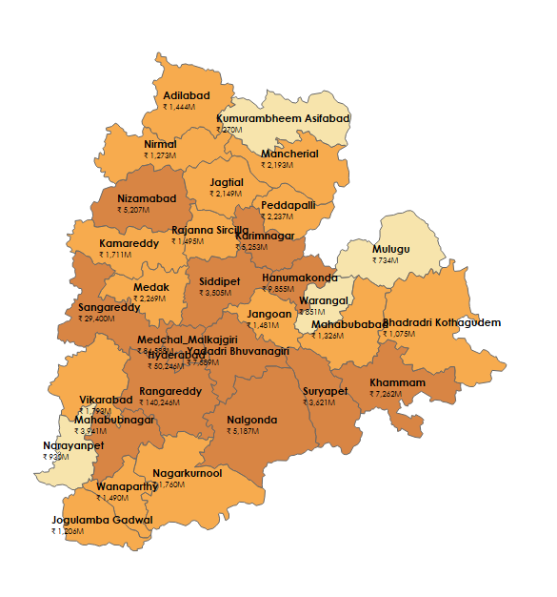
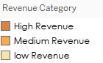
4. Categorize districts into three segments based on their stamp registration revenue generation during the fiscal year 2021 to 2022
District wise stamp registration fiscal year 2021 - 2022

Slide 18
4. Categorize districts into three segments based on their stamp registration revenue generation during the fiscal year 2021 to 2022
District wise stamp registration fiscal year 2021 - 2022
Kumurambheem Asifabad: Lowest revenue - ₹270 M
Kumurambheem Asifabad: Lowest revenue - 15.04 M
Rangareddy : Highest revenue - 76 bn INR
Rangareddy : Highest revenue – ₹140 B

Slide 19
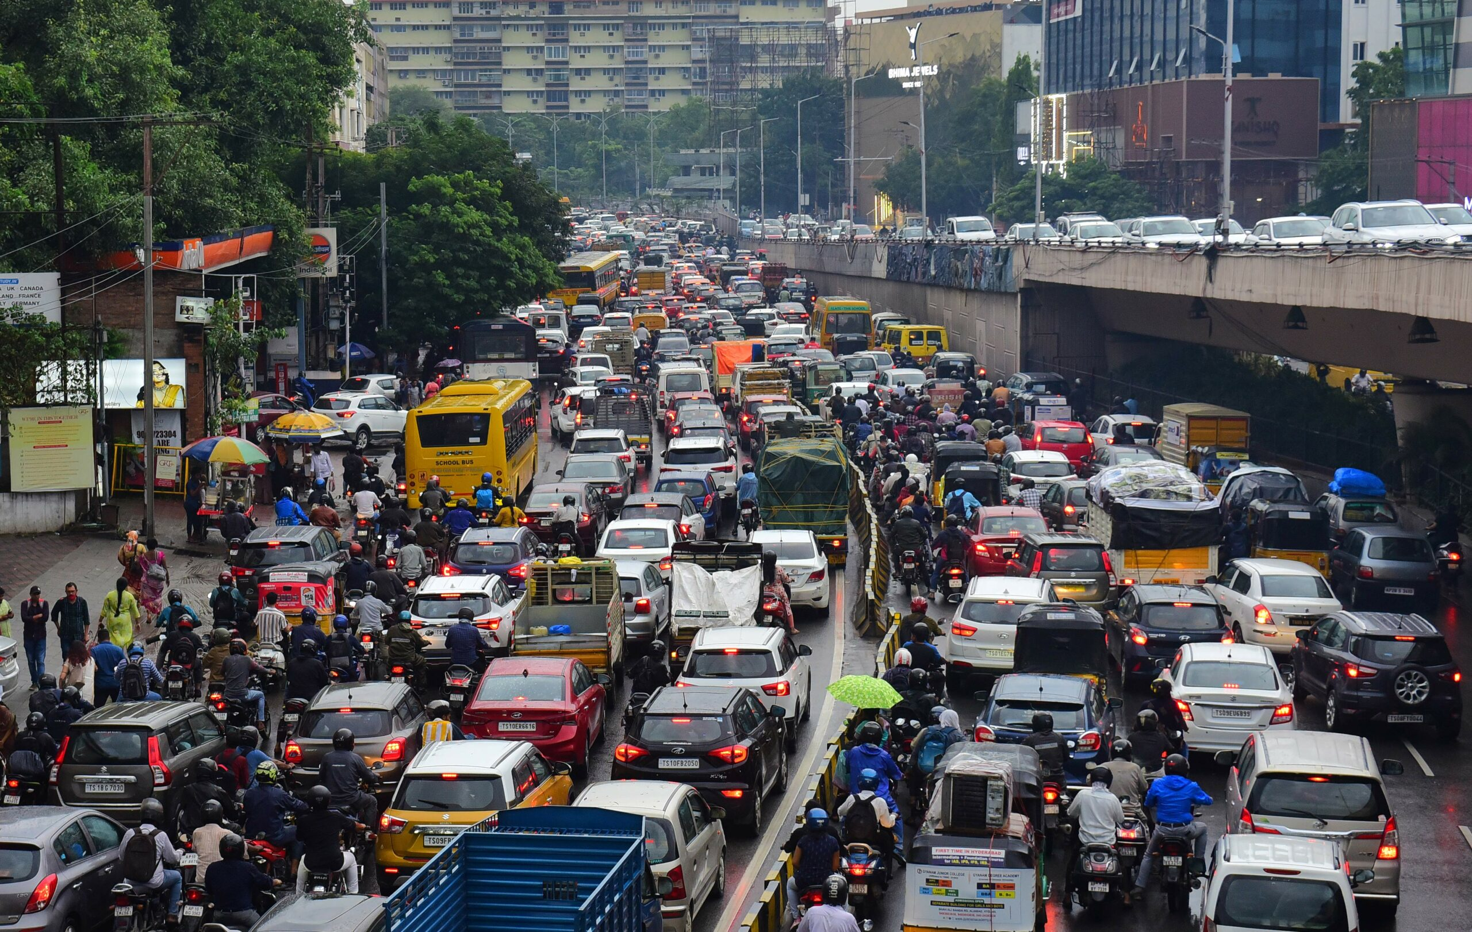
TRANSPORTAITON

Slide 20
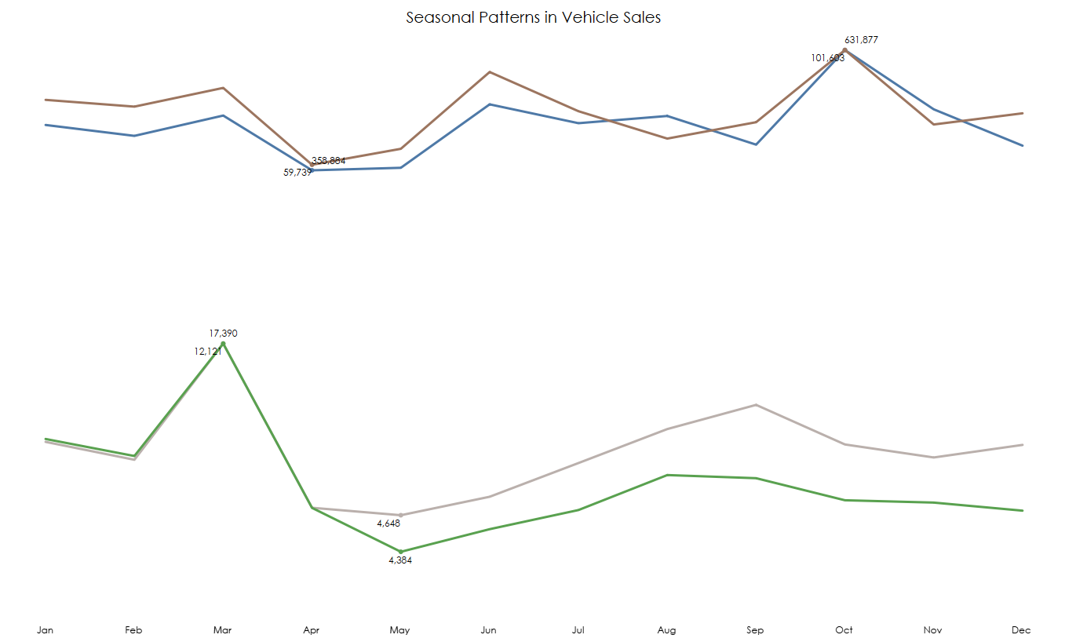
5. Investigate whether there is any correlation between vehicle sales and specific months or seasons in different districts. Are there any months or seasons that consistently show higher or lower sales rate, and if yes, what could be the driving factors? (Consider Fuel-Type category only)
Trends: Telangana witnesses a surge in petrol and diesel vehicle sales during October, driven by the festival season and year-end sales promotions that attract customers seeking affordable options. On the other hand, electric vehicle sales peak towards the fiscal year end in March, with consistent sales throughout the rest of the year.

Slide 21
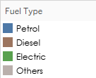
5. Investigate whether there is any correlation between vehicle sales and specific months or seasons in different districts. Are there any months or seasons that consistently show higher or lower sales rate, and if yes, what could be the driving factors? (Consider Fuel-Type category only)
Trends: Telangana witnesses a surge in petrol and diesel vehicle sales during October, driven by the festival season and year-end sales promotions that attract customers seeking affordable options. On the other hand, electric vehicle sales peak towards the fiscal year end in March, with consistent sales throughout the rest of the year.
s.

Slide 22
6. How does the distribution of vehicles vary by vehicle class (MotorCycle, MotorCar, AutoRickshaw, Agriculture) across different districts? Are there any districts with a predominant preference for a specific vehicle class? Consider FY 2022 for analysis.

Slide 23
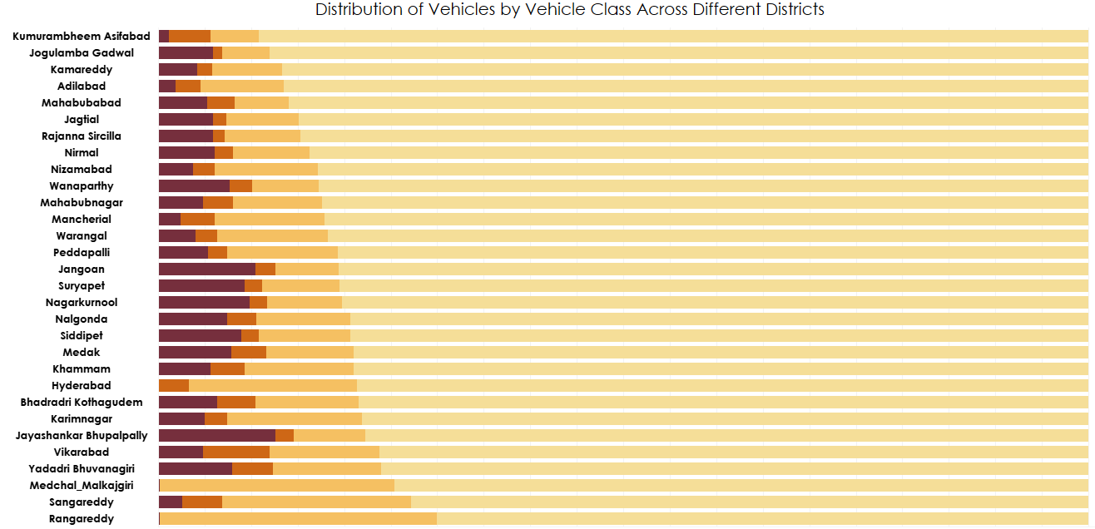
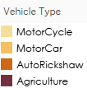
6. How does the distribution of vehicles vary by vehicle class (MotorCycle, MotorCar, AutoRickshaw, Agriculture) across different districts? Are there any districts with a predominant preference for a specific vehicle class? Consider FY 2022 for analysis.
Motorcycle Dominance: Across all districts, motorcycles are the predominant vehicle class, indicating a common preference for two-wheelers in all region.
Hyderabad, being the capital of Telangana, boasts the highest overall Motorcycle sales at 206,819 units. Among these sales, autorickshaws saw significant demand, with over 8,397 units sold, especially in urban areas due to their practicality and convenience.

Slide 24
7. List down the top 3 and bottom 3 districts that have shown the highest and lowest vehicle sales growth during FY 2022 compared to FY 2021? (Consider and compare categories: Petrol, Diesel and Electric)

Slide 25
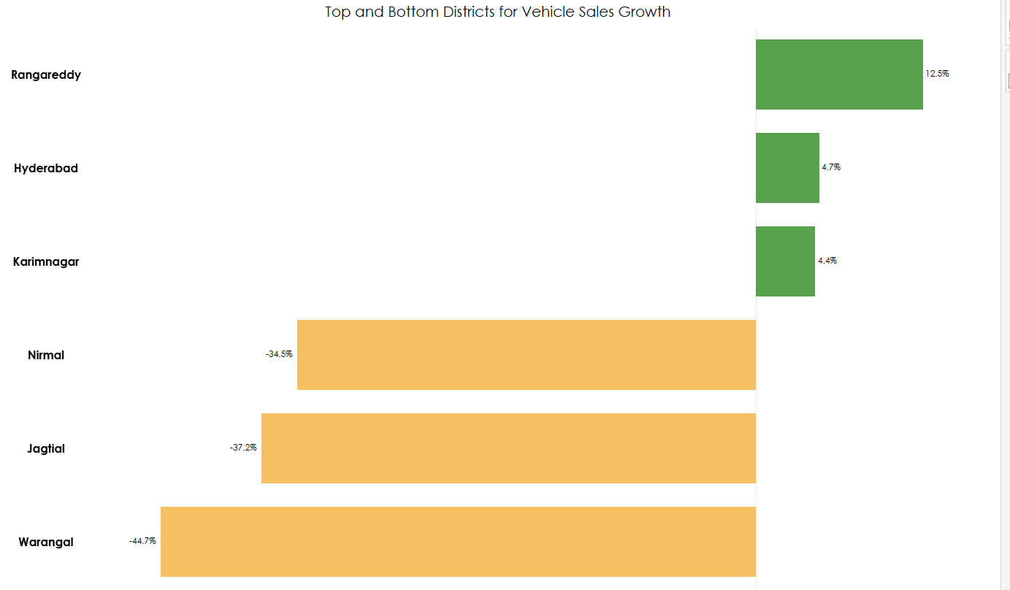
7. List down the top 3 and bottom 3 districts that have shown the highest and lowest vehicle sales growth during FY 2022 compared to FY 2021? (Consider and compare categories: Petrol, Diesel and Electric)

Slide 26

Ts-Ipass Telangana State Industrial Project Approval and Self Certification System

Slide 27
8. List down the top 5 sectors that have witnessed the most significant investments in FY 2022

Slide 28
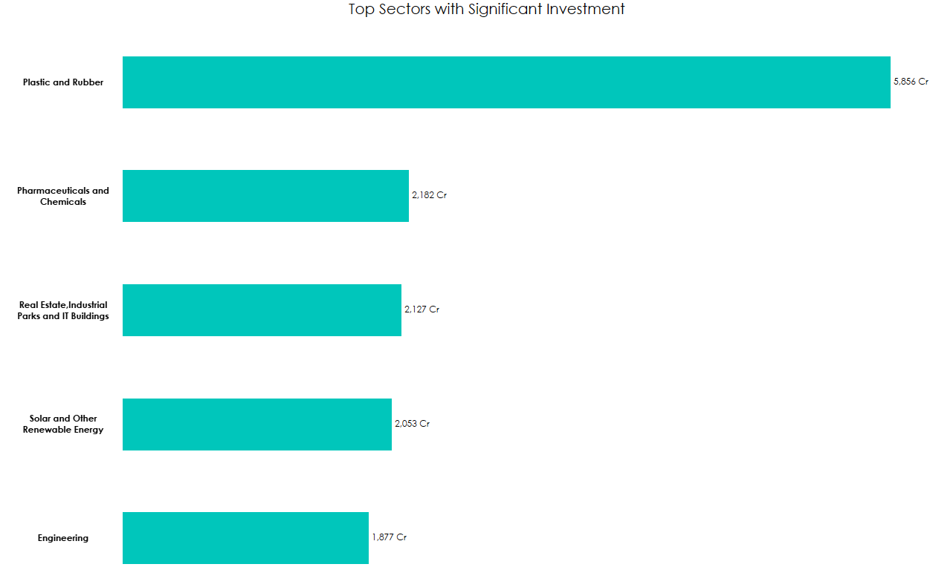
8. List down the top 5 sectors that have witnessed the most significant investments in FY 2022
These investments signify a diversified economic landscape in FY 2022, with a significant emphasis on industries such as plastics, pharmaceuticals, real estate, renewable energy, and engineering. These sectors play a crucial role in driving economic growth and development in the region.

Slide 29
9. List down the top 3 districts that have attracted the most significant sector investments during FY 2019 to 2022? What factors could have led to the substantial investments in these particular districts?

Slide 30
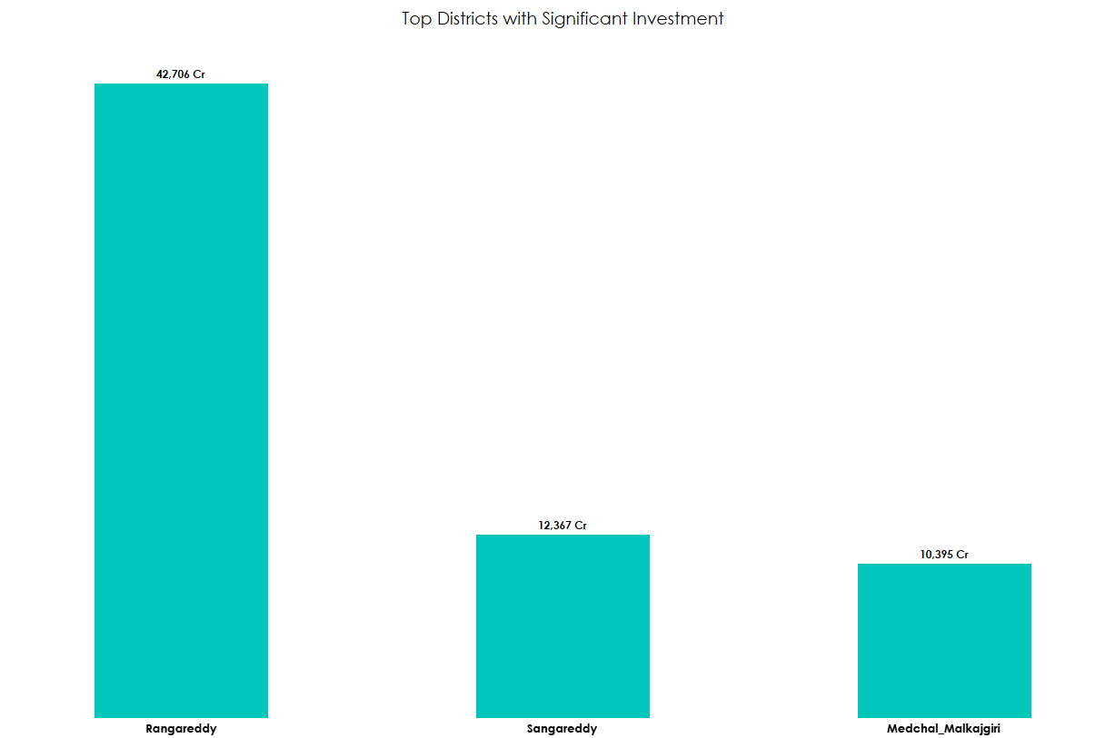
9. List down the top 3 districts that have attracted the most significant sector investments during FY 2019 to 2022? What factors could have led to the substantial investments in these particular districts?
Proximity to Hyderabad: All three districts are in close proximity to Hyderabad, the state capital and an economic hub. This proximity provides access to a skilled workforce, infrastructure, and market opportunities, making them favorable locations for investments.
Industrial Infrastructure: These districts have developed industrial parks, technology zones, and IT clusters, creating an enabling environment for businesses to thrive.
Government Policies: The government's pro-business policies, investment incentives, and ease of doing business initiatives have encouraged companies to invest in these districts.
Connectivity: Good transportation networks and connectivity to major cities and ports enhance the attractiveness of these districts for logistics and manufacturing companies.
Economic Diversification: The districts have diversified economies, with a focus on sectors like IT, manufacturing, real estate, and pharmaceuticals, attracting a wide range of investments.
.

Slide 31
10. Is there any relationship between district investments, vehicles sales and stamps revenue within the same district between FY 2021 and 2022?

Slide 32
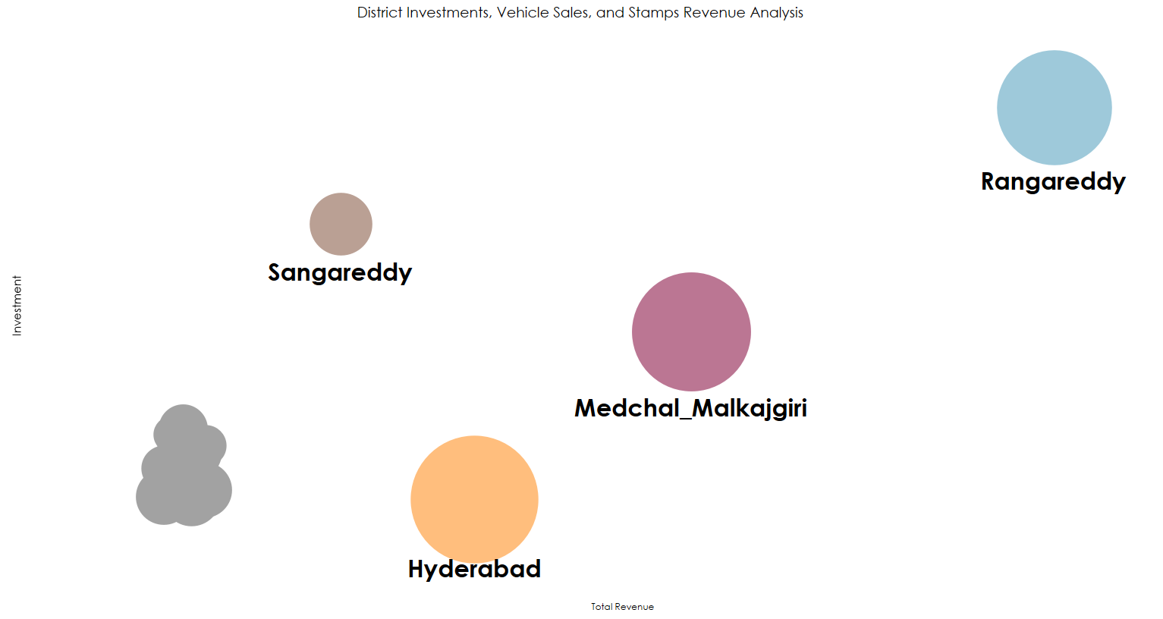
10. Is there any relationship between district investments, vehicles sales and stamps revenue within the same district between FY 2021 and 2022?
District Investment and Stamp Revenue
A linear relationship is observed between district investments and stamp revenue. As investments in a district increase, stamp revenue also tends to increase. This suggests that economic activity and investments have a positive impact on stamp revenue generation.

Slide 33
11. Are there any particular sectors that have shown substantial investment in multiple districts between FY 2021 and 2022?

Slide 34
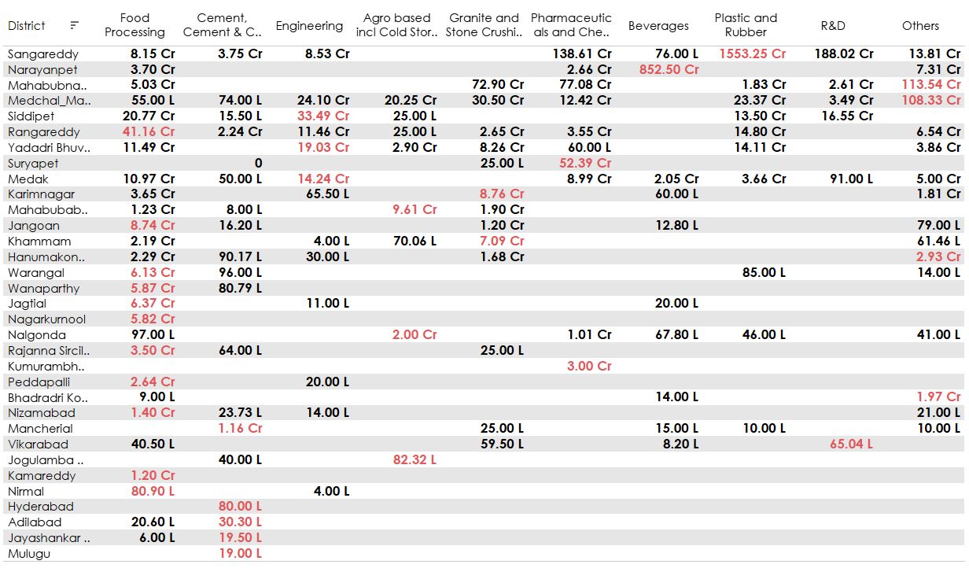
11. Are there any particular sectors that have shown substantial investment in multiple districts between FY 2021 and 2022?

Slide 35
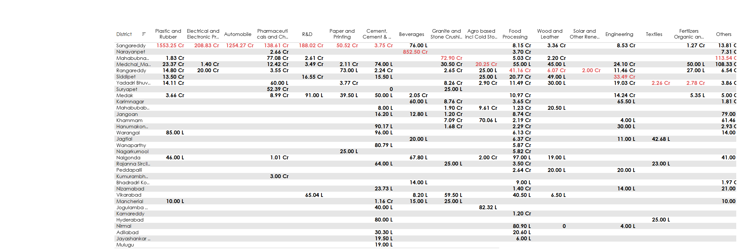
11. Are there any particular sectors that have shown substantial investment in multiple districts between FY 2021 and 2022?

Slide 36
12. Can we identify any seasonal patterns or cyclicality in the investment trends for specific sectors? Do certain sectors experience higher investments during particular months?

Slide 37
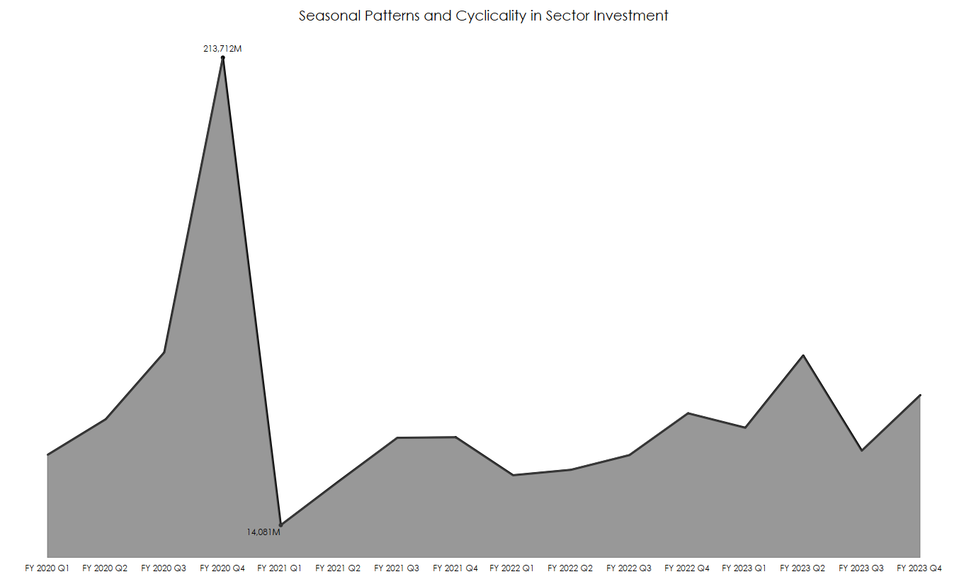
12. Can we identify any seasonal patterns or cyclicality in the investment trends for specific sectors? Do certain sectors experience higher investments during particular months?
Overall Sector Investments:
FY 2021 Q1 records the lowest overall sector investments at 14,081 M, while FY 2020 Q4 stands out with the highest investments at 213,712 M.

Slide 38
Agro-Based and Cold Storage
The Agro-Based sector, specifically Cold Storage, experiences its highest investments in June at 6,058 M, which aligns with the agricultural harvest season.
R&D Sector:
There is a noticeable trend where investments are consistently lower during the third quarter (October to December) compared to the rest of the year. Investment in R&D is notably higher in the other three quarters.
Beverages
Beverages back-to-back invested heavily in the particular district of Narayanpet .They seem to follow a seasonal pattern of substantial investments in both the third and fourth quarters
Electric and Electronic
Invested during the second and fourth quarters, displaying a seasonal pattern of alternating investments from one quarter to the other.
.
Engineering Sector:
Investments in the engineering sector notably increase in February 2021, an investment of 6,373 million was allocated to Rangareddy for infrastructure and development.
Pharmaceuticals and Chemicals:
Pharmaceuticals and chemical industries significantly increased their investments in two districts, Medchal-Malkajgiri and Sangareddy, following the peak of the COVID-19 pandemic in June 2021.
.
Real Estate, Industrial Parks, and IT Buildings:
This sector experienced substantial investments in February 2020, amounting to 177,934 M in Rangareddy district, indicating a potential pattern related to fiscal year-end planning.
Textiles
Investments in this sector are highest in September, reaching 11,918 M.

Slide 39
SECONDARY INSIGHTS

Slide 40
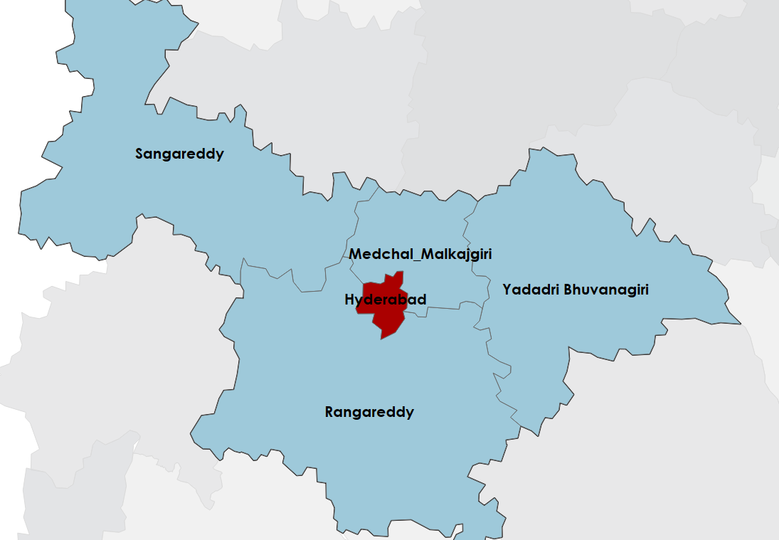
Top 5 districts to buy commercial properties in Telangana

Slide 41
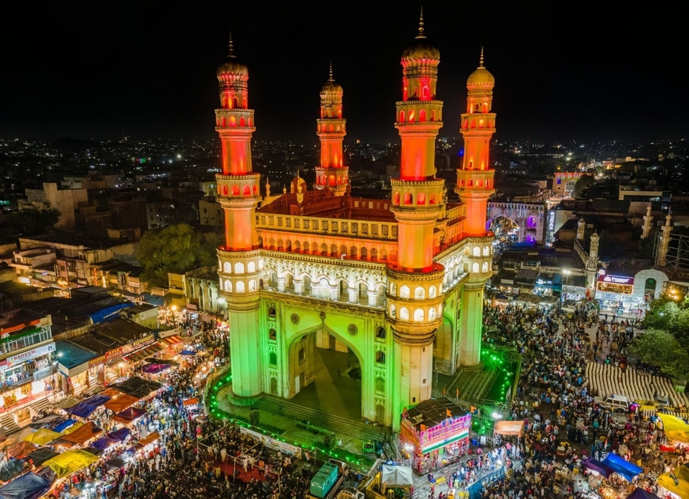

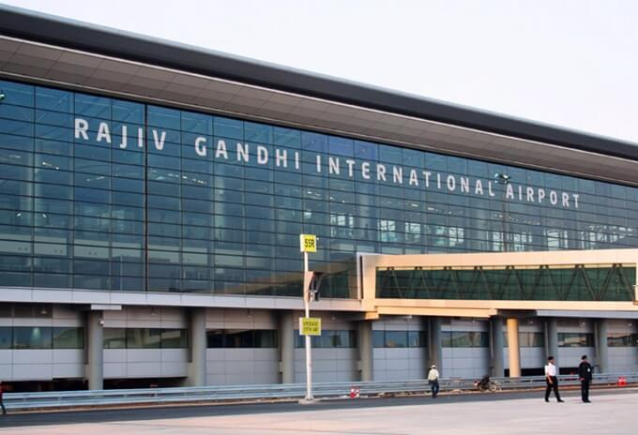
Top 5 districts to buy commercial properties in Telangana
Hyderabad
Rangareddy
Justification: Hyderabad, as the capital city of Telangana, is a prime location for commercial real estate. It has a strong economy, a well-developed infrastructure, and a growing IT and business sector. Areas like HITEC City, Gachibowli, and Banjara Hills are particularly popular for commercial investments.
.
Justification: Known for industrial corridors, proximity to the international airport, growing commercial zones, and a significant recent investment of 28,970 crores in the real estate sector.
.

Slide 42
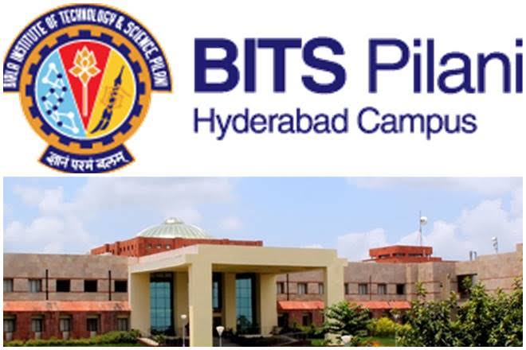
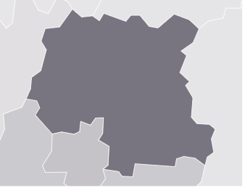
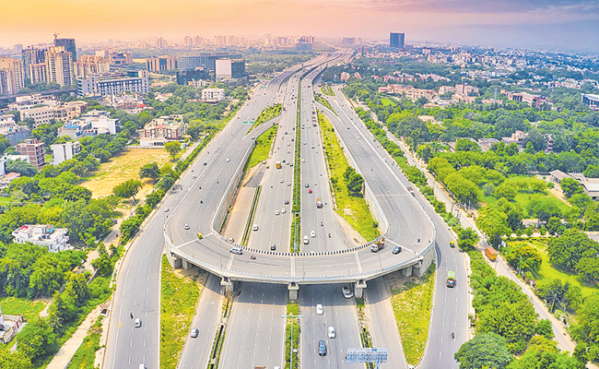
Medchal Malkajgiri
Sangareddy
Justification: This District's is the second most populous and highly urbanized district after Hyderabad, marked by its rapid growth, proximity to educational and IT hubs, and strong connectivity, establishing it as an emerging commercial hub within the Hyderabad Metropolitan Region.
Justification: This District, strategically positioned along National Highway 65 and boasting the second-highest investment of 12,367 crores in the region, offers immense potential for logistics and warehousing businesses while also maintaining a strong foothold in agriculture and the dairy industry.

Slide 43

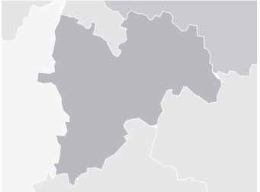
Yadadri Bhuvanagiri
Justification: This district in Telangana offers strategic commercial opportunities due to its location on National Highway 163, proximity to Hyderabad, growth in industrial and manufacturing sectors, agriculture, education, healthcare, and government initiatives. Potential commercial ventures include manufacturing, agriculture-related businesses, real estate development, retail, and trade, but thorough market research and due diligence are essential for investors considering this district for commercial investments.

Slide 44
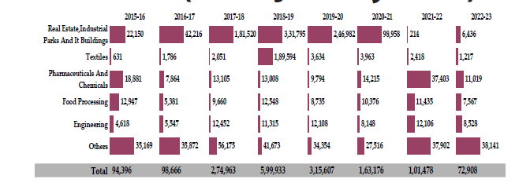
What significant policies or initiatives were put into effect to enhance economic growth, investments, and employment in Telangana by the current government? Can we quantify the impact of these policies using available data?
TS-iPASS: This flagship program has attracted significant investments and created employment opportunities. In the fiscal year 2021-22, TS-iPASS attracted INR 17,889 Crores of investment through 3,938 new industries and created employment for 95,982 people. Cumulatively, TS-iPASS has attracted investments of INR 2,32,311 Crores and created employment for 16.48 lakhs people

Slide 45
What significant policies or initiatives were put into effect to enhance economic growth, investments, and employment in Telangana by the current government? Can we quantify the impact of these policies using available data?
Technology-Hub(T-HUB):
T-Hub, established in 2015, is a key innovation intermediary and incubator in Hyderabad, dedicated to promoting entrepreneurship in Telangana.
It has made significant contributions to innovation, entrepreneurship, and ecosystem development, surpassing over 55 other participating incubators in India.
T-Hub's impact extends to supporting 2500+ startups, hosting 1000+ events, and creating more than 12,000 jobs in Telangana.
The launch of T-Hub Phase 2 in June 2022 has further solidified its position as one of the world's largest innovation campuses, with a capacity to accommodate 4,000 startups.
Telangana's innovation policies and startup incentives, coupled with T-Hub's efforts, have fostered the success of startups like "Darwin Box" and "Skyroot Aerospace," with the former joining the unicorn club and the latter developing India's first private rocket.

Slide 46
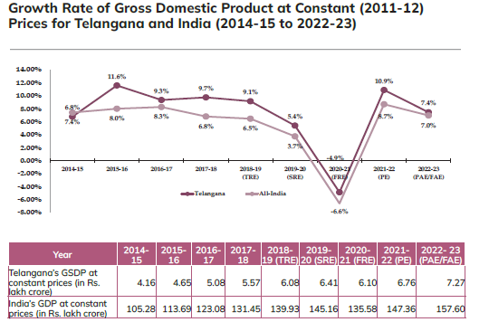
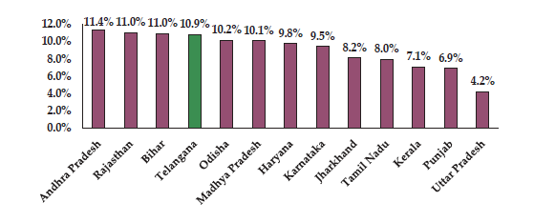
What significant policies or initiatives were put into effect to enhance economic growth, investments, and employment in Telangana by the current government? Can we quantify the impact of these policies using available data?
Telangana's economic growth has come a long way since its formation. Initially, it started with a lower growth rate compared to the national average. However, the following year, it exceeded the national growth rate by 3.6 percentage points. Since 2015-16, Telangana's real growth rate has consistently outpaced the national average. In 2022-23, the gap between Telangana's GSDP growth rate and India's GDP growth rate was just 0.4 percentage points.

Slide 47
Provide top 5 Insights & 5 recommendations to Telangana government for sustained growth in the next 5 years based on your analysis.
Top Insights:
Leverage the Tech Ecosystem: Telangana has a thriving tech ecosystem in Hyderabad. To sustain growth, the government should continue to promote technology innovation, support startups, and foster a favorable environment for tech companies. Investments in emerging tech fields like AI, blockchain, and biotechnology can further strengthen the state's technological edge.
Infrastructure Development: Focusing on infrastructure development, especially in rural areas, can spur economic growth. Improved connectivity, modernized transportation, and enhanced logistics can attract industries and create jobs beyond urban centers.
Agriculture Diversification: Encouraging diversification in agriculture, promoting agribusiness, and implementing efficient water management practices can boost agricultural productivity and income for farmers, leading to rural development.
Skilling and Education: Invest in skill development and education to create a highly skilled and adaptable workforce. Align educational institutions with industry needs to address the skills gap and enhance employability.
Sustainable Practices: Embrace sustainability in all sectors. Promote renewable energy adoption, sustainable agriculture, and eco-friendly manufacturing to ensure long-term environmental and economic sustainability.

Slide 48
Recommendations for Sustained Growth:
Leverage the Tech Ecosystem: Invest in Innovation Hubs: Establish innovation hubs in different regions of the state to encourage entrepreneurship and innovation outside of Hyderabad. These hubs can focus on local strengths and attract diverse industries.
Ease of Doing Business: Continuously improve the ease of doing business through simplified regulatory processes and transparent approvals. Implement digital solutions to streamline administrative procedures and reduce bureaucratic hurdles for businesses.
Agricultural Reforms: Implement policies that encourage crop diversification, provide access to modern farming techniques, and create markets for high-value agricultural products. Promote farmer producer organizations and Agri-tech startups.
Skill Reskilling and Upskilling: Develop a comprehensive skill development framework that aligns with emerging industry needs. Invest in vocational training and reskilling programs to ensure the workforce remains competitive in a rapidly evolving job market.
Smart Urban Planning: Plan urban development with a focus on sustainability, efficient public transportation, and affordable housing. Encourage the development of satellite towns to decongest urban centers and distribute economic growth more evenly.

Slide 49
Thank you

